Slide 1

Green Pace
Security Policy Presentation
Developer: Drew Shepard

Slide 2

OVERVIEW: DEFENSE IN DEPTH
This is a model for cyber security and the defense in depth illustration. This helps keep data secured. The layers provide different strategies to defend against attack. The more layers there are the more secure it will be.

Slide 3
THREATS MATRIX
Likely STD-001-C++ STD-002-C++ STD-003-C++ STD-004-C++ STD-005-C++ | Priority STD-008-C++ STD-009-C++ STD-010-C++
Low priority STD-007-C++ | Unlikely STD-006-C++
The threat matrix prioritizes threat levels.

Slide 4
10 PRINCIPLES
Validate input
Heed compiler warnings
Architect and design for security policies
Keep it simple
Default deny
Adhere to the principle of least privilege
Sanitize data sent to other systems
Practice defense in depth
Use effective assurance techniques
Adopt a secure coding standard

Slide 5
CODING STANDARDS
Data Type: Priority level medium
Data Value: Priority level medium
String correctness: Priority level high
SQL Injection: Priority level high
Memory Protection: Priority level high
Assertions: Priority level low
Exceptions: Priority level low
File Handling: Priority level medium
Cross-site Scripting Prevention: Priority level medium
Authentication and Password Storage: Priority level medium

Slide 6
ENCRYPTION POLICIES
Encryption in flight: All data transmitted over networks must be encrypted using secure protocols like TLS/SSL. Ensure encryption for data transfers between client-server, serve-database, and any other data exchange points.
Encryption at Rest: Sensitive data stored in databases, file systems, and storage devices must be encrypted using strong algorithms like AES. Encryption keys should be securely managed and stored separately from the encrypted data.
Encryption in Use: Sensitive data being processed must be encrypted while in memory. Implement techniques such as memory encryption to protect against memory scraping attacks.

Slide 7
TRIPLE-A POLICIES
Authentication: This policy requires multi-factor authentication for access to sensitive systems. Strong password policies and regular password updates need to be enforced.
Authorization: This policy implements role-based access control for granting permissions. Applying the principle of least privilege to restrict access to only necessary resources.
Accounting: This policy logs all system activities and user interactions and establishes audit trails for tracking changes and actions.

Slide 8
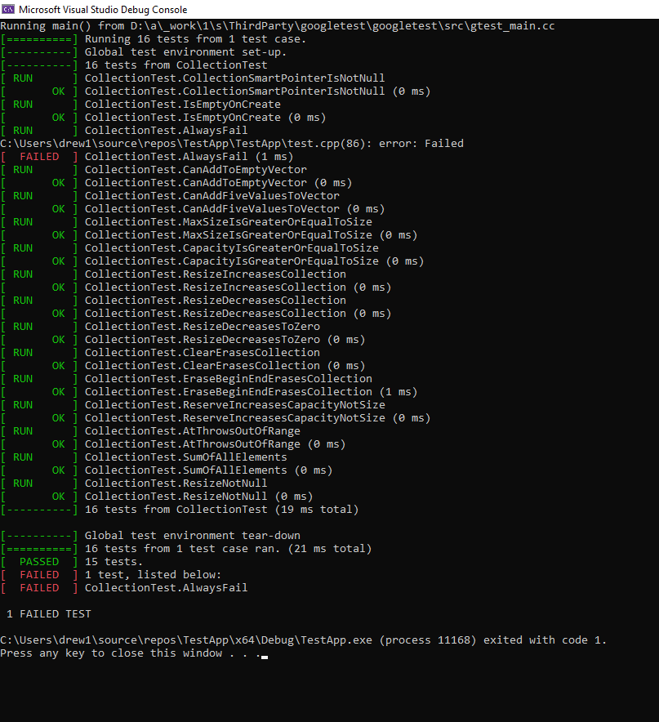
Unit Testing
Unit tests help to limit vulnerabilities within the software. Buffer overflow unit tests will catch errors if a user attempts to input more than the max character limit. This limits the user’s character input to prevent the vulnerability.

Slide 9

AUTOMATION SUMMARY

Slide 10
TOOLS
Planning and design: In the planning phase, we use threat modeling tools to identify potential security threats and vulnerabilities. This informs our security strategy and ensures we build with security in mind.
Code development: During code development, security linters and IDE plugins provide instant feedback to developers, highlighting code vulnerabilities and adherence to coding standards.
Testing: Static analysis tools scan the codebase for vulnerabilities during the build process, ensuring that potential issues are caught before the code progresses further.
Testing: Dynamic analysis tools test the application during runtime, identifying vulnerabilities in a real-world context. Fuzz testing tools introduce unexpected inputs to assess the application’s resilience against potential attacks. Security testing frameworks automate security-specific tests, simulating attacks like SQL injection and cross-site scripting
Deployment and monitoring: container security scanners assess container images for known vulnerabilities, ensuring secure deployments.
Feedback and iteration: continuous integration continuously integrates code and tests, providing feedback loops for rapid security updates.
Release and continuous improvement: vulnerability management tools help track and manage vulnerabilities in the developed software, allowing for prompt security updates.

Slide 11
RISKS AND BENEFITS
Problem: Delayed vulnerability detection, Our strategy may lead to delayed detection of vulnerabilities, particularly those introduced in later stages. This increases the risk of critical issues reaching production.
Solution: implementing a comprehensive security training program to keep developers updated with the latest security threats and mitigation techniques.
Risks and Benefits of Acting Now:
Risks: immediate changes might disrupt the existing workflow and require adjustment periods. Resources and time will be needed to implement new measures.
Benefits: Early action will result in more vulnerabilities being caught early, reducing remediation costs and potential security breaches.
Risks and Benefits of Waiting:
Risks: Delaying changes exposes us to potential security breaches and vulnerabilities slipping through. It also delays the implementation of better practices.
Benefits: Temporary continuity in the existing workflow.

Slide 12
RECOMMENDATIONS
Current Gaps:
Threat Detection and Response: Our current policy might lack a detailed strategy for real-time threat detection and rapid incident response. This could lead to delayed responses and heightened impact in case of security breaches.
Third-Party Risk Management: While we address internal security practices, our policy might not adequately address the risks posed by third-party services or components. This could expose us to vulnerabilities originating from external sources.
Standards to Adopt:
Zero Trust Architecture: To address current gaps, we should adopt a Zero Trust Architecture. This approach assumes that threats exist both inside and outside the network and enforces strict access controls and continuous monitoring.
ISO/IEC 27001: To strengthen our third-party risk management, we should consider adopting the ISO/IEC/ 27001 standard. This framework provides a structured approach to information security management, including third-party risk assessment and management.

Slide 13
CONCLUSIONS
[Identify standards that should be adopted to prevent future problems.]
ISO/IEC 27001 – Information security management: This provides a comprehensive framework for information security management. It encompasses a systematic approach to identifying, assessing, and mitigating risks related to information security. By adopting ISO/IEC 27001, we establish a structured process for addressing security vulnerabilities, ensuring that our systems and data are well protected.
NIST Cybersecurity Framework: The NIST Cybersecurity Framework offers guidelines, best practices, and standards to manage cybersecurity risks. It emphasizes risk assessment, threat detection, and incident response. Integrating the NIST Framework into our strategy provides a holistic approach to identifying and mitigating potential problems before they escalate.
OWASP Application Security Verification Standard: The OWASP ASVS is a comprehensive framework for building and verifying secure applications. It provides guidelines for security requirements, verification activities, and testing techniques
CIS Critical Security Controls: The CIS Critical Security Controls offer a prioritized set of actions for enhancing cybersecurity posture. These controls focus on foundational security measures that significantly reduce the risk of cyberattacks. By aligning our security practices with the CIS controls, we establish a strong foundation that helps prevent a wide range of potential problems.

Slide 14
REFERENCES
J. (2022, May 2). A Complete Guide to Encryption--Data at Rest, Data in Motion, and Data in Use. Jatheon. Retrieved August 12, 2023, from https://jatheon.com/blog/data-at-rest-data-in-motion-data-in-use/
S. (2021, October 28). Computer Network | AAA (Authentication, Authorization and Accounting). Geeksforgeeks. Retrieved August 12, 2023, from https://www.geeksforgeeks.org/computer-network-aaa-authentication-authorization-and-accounting/
Bose, S. (2023, April 20). Coding Standards and Best Practieces to Follow. Browerstack. Retrieved August 12, 2023, from https://www.browserstack.com/guide/coding-standards-best-practices#:~:text=Coding%20standards%20are%20a%20set,efficient%20code%20with%20minimal%20errors.
I. (2022, October 1). ISO/IEC 27001 Information security management systems. Iso. Retrieved August 12, 2023, from https://www.iso.org/standard/27001

